Slide 1
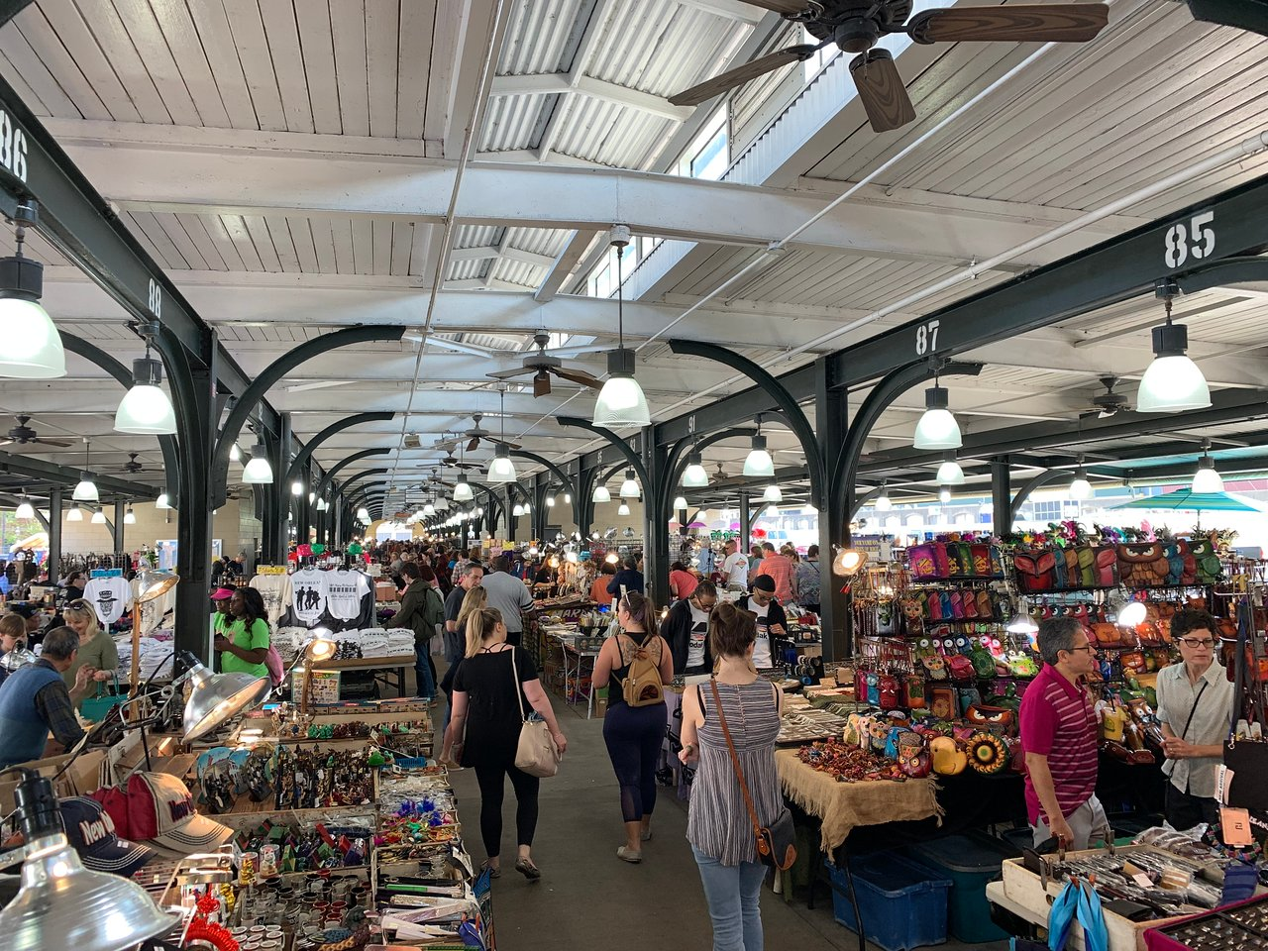
Let’s envision the future of the French Market!
Notes:
Leslie Intro

Slide 2
Thanks for joining us!
Notes:
Leslie Intro

Slide 3
Our Team
Notes:
Leslie Intro

Slide 4
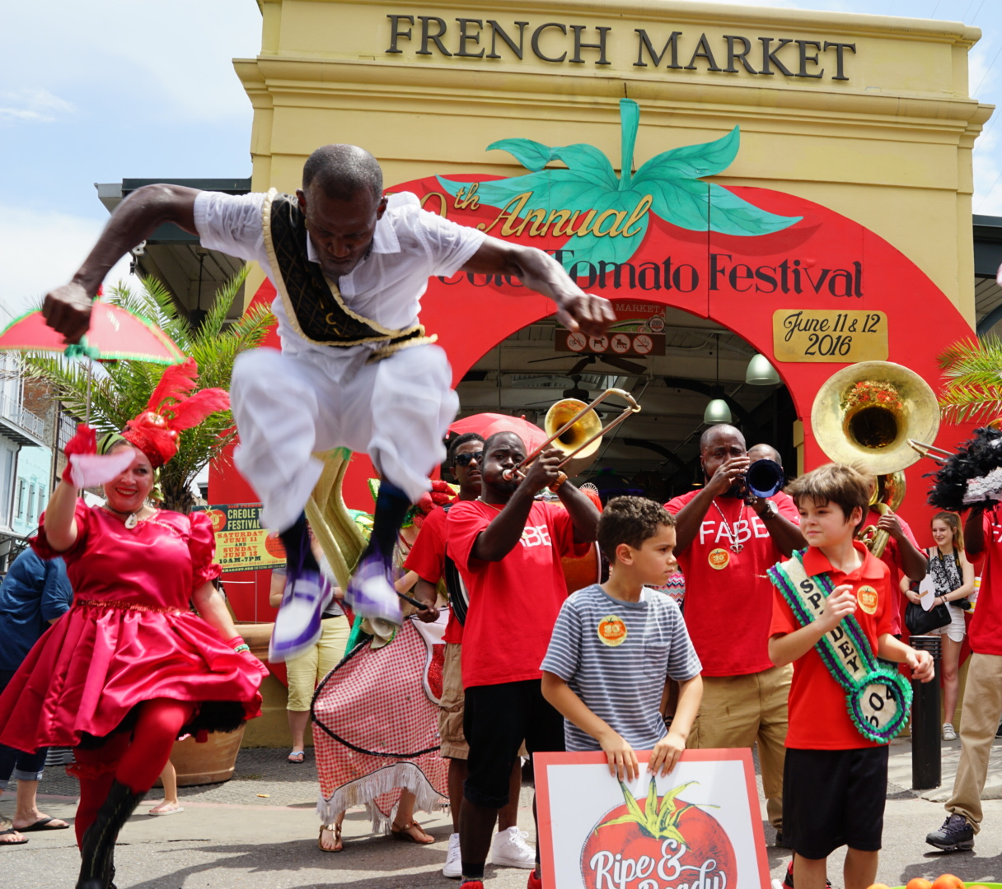
Project Overview & Goals
Envision a French Market that supports local culture bearers and advances the city’s cultural economy.
Develop programming and operations that serves the local public and promotes sustainable tourism.
Identify short, medium, & long-term capital investments at French Market.
Notes:
Leslie Intro

Slide 5
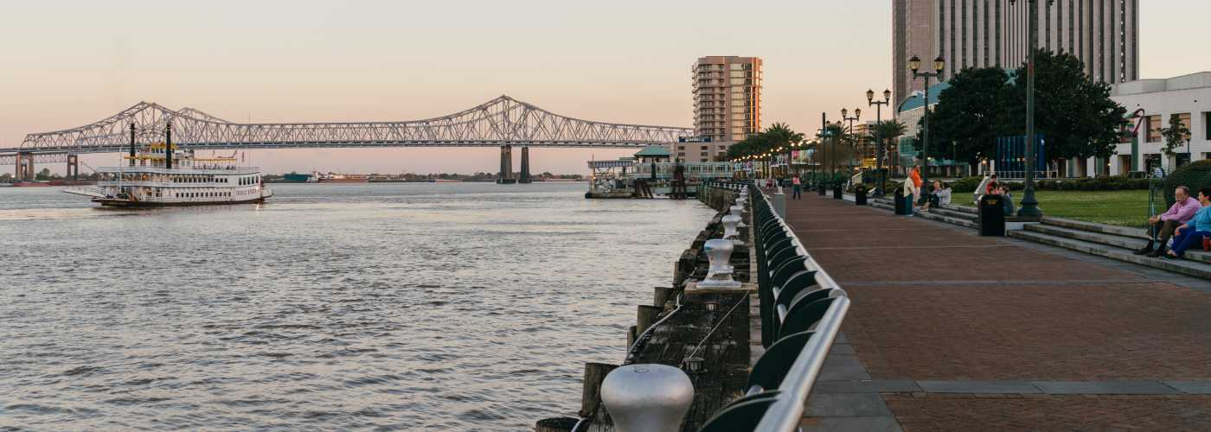
Today’s Agenda
Project Overview & Process
Round 1 Engagement: Common Themes
Theory of Change (Work in Progress)
Breakout Rooms: Programming & Operations
Debrief & Next Steps
Notes:
Bahareh: Thanks for the introductions, Leslie! Welcome, everyone! I know some of you have already participated in the first round of engagement and some of you are joining us for the first time today. So we’ll start with a brief poll to get an idea of who’s in the room with us tonight (it will pop up on your screen). While you answer the poll, I’ll share the agenda for tonight’s call. We’ve condensed tonight’s call to be one hour out of respect for your time and based on feedback we received.
Leslie kicked us off with the project overview and goals. We will also share our process with you in a moment.
Then we will share some of the common themes we heard in the first round of engagement meetings and a working theory of change that was informed by those common themes.
We’ll have thirty minutes in small breakout rooms for some interactive jamboard activities and discussion around Programming & Operations.
And finally, we will return to this main room to debrief & discuss next steps.

Slide 6
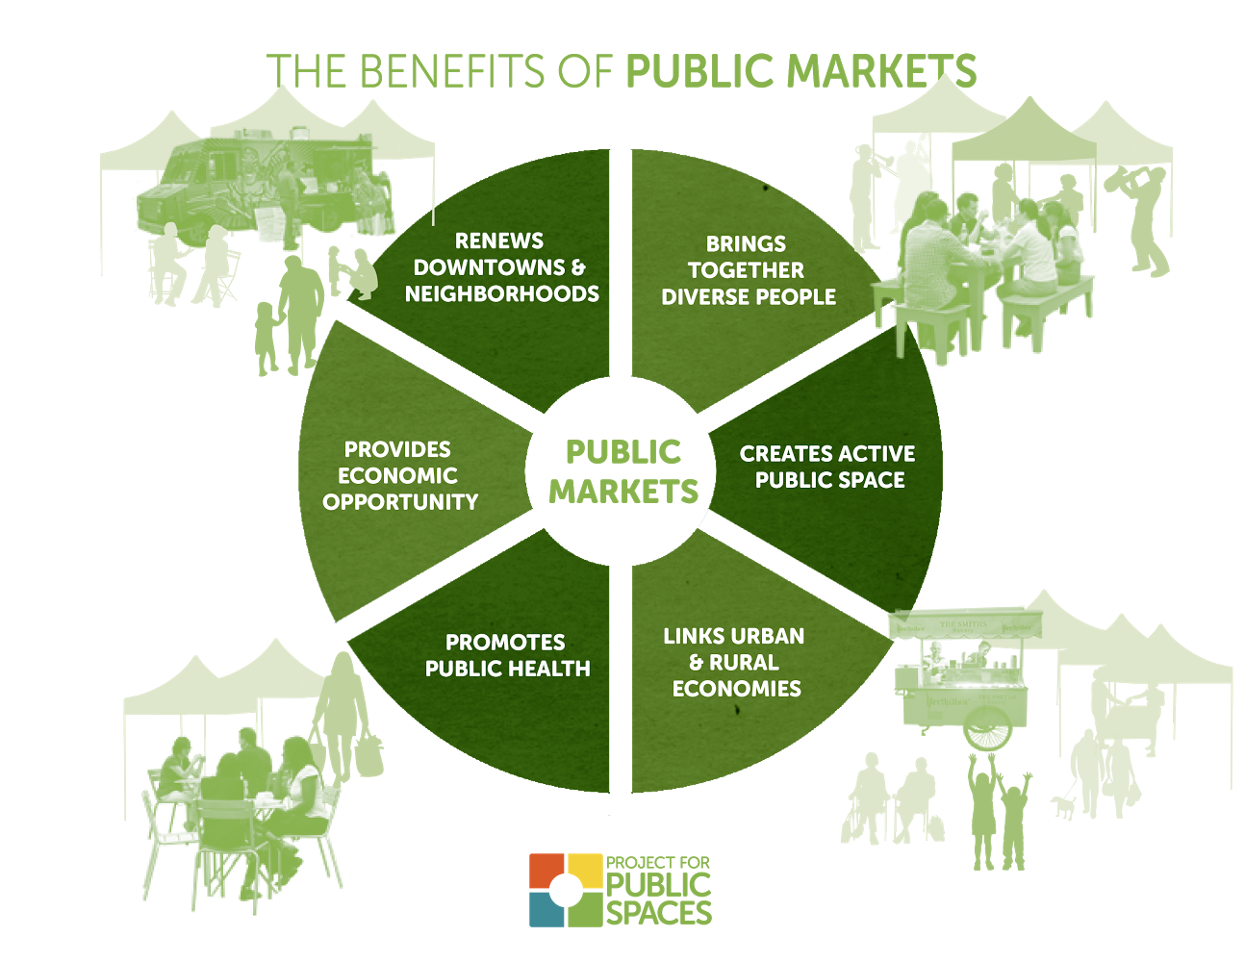
Building On Past Work…
Notes:
We are reviewing and building on past studies that have been done by Project for Public Spaces at the French Market. In our analysis, we are identifying key insights from these past studies that are still relevant today and adding to those recommendations through this current research and stakeholder engagement process.

Slide 7
Stakeholder Engagement Timeline
M1
M2
M3
Jan./Feb.
Feb.
Mar.
Spring ‘21
Culture & Mission
Programming & Operations
Facilities Assessment & Visioning
FINAL
RECOMMENDATIONS
249
participants
127
participants
172
participants
179
participants
727
attendees
Notes:
In addition to research and analysis, stakeholder engagement is an essential part of our process for this study. This is the second of three engagement rounds that we are hosting. The first round of meetings focused on discussion around the French Market’s Culture & Mission. Today’s meeting will focus on Programming & Operations at the flea & food sheds. The next round will be around Facilities Assessment & Visioning. Each meeting will build on feedback we receive from the previous round of meetings and culminate in a final recommendations document that will be issued in the Spring. Our final document will be shared publicly on the French Market’s website and distributed directly to everyone who participates in the process.

Slide 8
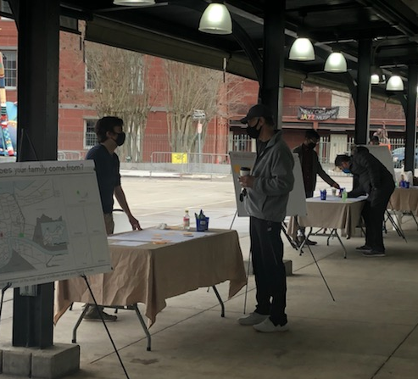
Round 1 Engagement: Common Themes
40+ vendors said…
FM should celebrate the diversity of its vendors while highlighting products.
FM should advertise more to get people to the market.
French Market should attract mostly tourists and serve locals.
French Market should continue to empower vendors through business incubation & technical support.
FM adds historical, cultural, and economic value to New Orleans.
French Market should implement sustainable / green practices.
Notes:
The complete results from our first round of engagement will be published to the FM website by the end of this week so please be on the look out. We will also share a link directly to anyone who registered for this or the previous meetings.
We held 3 sessions in the first round of engagement, starting with the current vendors underneath the flea market shed. We met with vendors during their usual Thursday morning stall assignment and set up since they would already be on site at that time. Approximately 40 vendors participated in this session and some common themes that we heard from them included…

Slide 9
Round 1 Engagement: Common Themes
50+ public stakeholders said…
Highlight local arts & crafts.
Provide variety through pop-ups & collaborations with other markets
Serve visitors, locals, & engage the youth.
Highlight French Market history & culture through educational programming.
The French Market should feel safe & clean.
Notes:
Public (Virtual) Meeting…

Slide 10
Round 1 Engagement: Common Themes
30+ culture bearers said…
Prioritize Local New Orleanians & Equity
Offer more opportunities to involve local culture bearers and pay them fairly.
Cultural Events that share and teach about the traditions of BIPOC in an authentic, respectful way.
Create a family friendly environment with child services, events, and activities.
Notes:
After our public meeting, we discovered that not enough culture bearer voices were included so we held a special follow-up meeting with the same content from the public meeting and invited local culture bearers to join the conversation.
We had approximately 30 culture bearer stakeholders participate in this call. The group included people who identified as culture bearers, culture bearer advocates, and local organizational representatives.

Slide 11
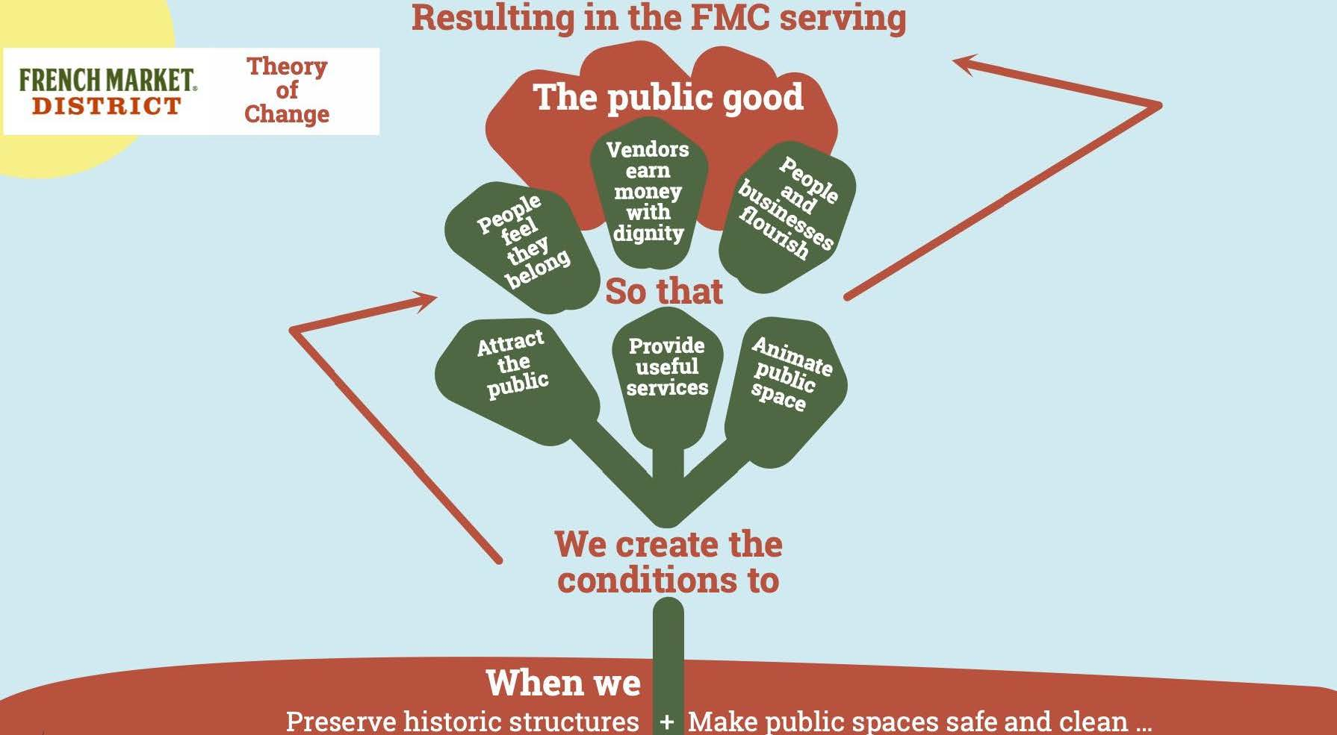
Notes:
Now I’d like to invite Richard McCarthy to share this working Theory of Change which came about as a direct result from the initial feedback we received.

Slide 12
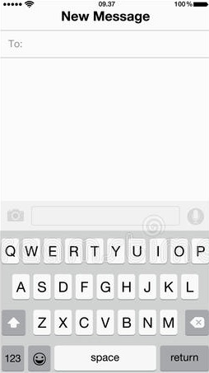
22333
LET’S SET UP OUR PHONES FOR POLLING QUESTIONS!
(YOU SHOULD RECEIVE A CONFIRMATION TEXT)
CONCORDIA477
Notes:
We would like to invite you to give us additional insight on this working theory of change with some follow-up questions to reflect on. Please grab your phone & set it up for polling….

Slide 13
Notes:
Poll Title: How should the French Market's history be preserved? https://www.polleverywhere.com/free_text_polls/HBPlZuxVe5fZUzcur076p

Slide 14
Notes:
Poll Title: What would it mean to you for the French Market to feel safe and clean? https://www.polleverywhere.com/free_text_polls/5ubvUalozp3Gq3smf8M3b

Slide 15
Notes:
Poll Title: What does equity at French Market mean and look like to you? https://www.polleverywhere.com/free_text_polls/nuiDyNbooiA8XNgFVtqYH

Slide 16
LET’S TALK ABOUT FRENCH MARKET’S PROGRAMMING & OPERATIONS.

Slide 17
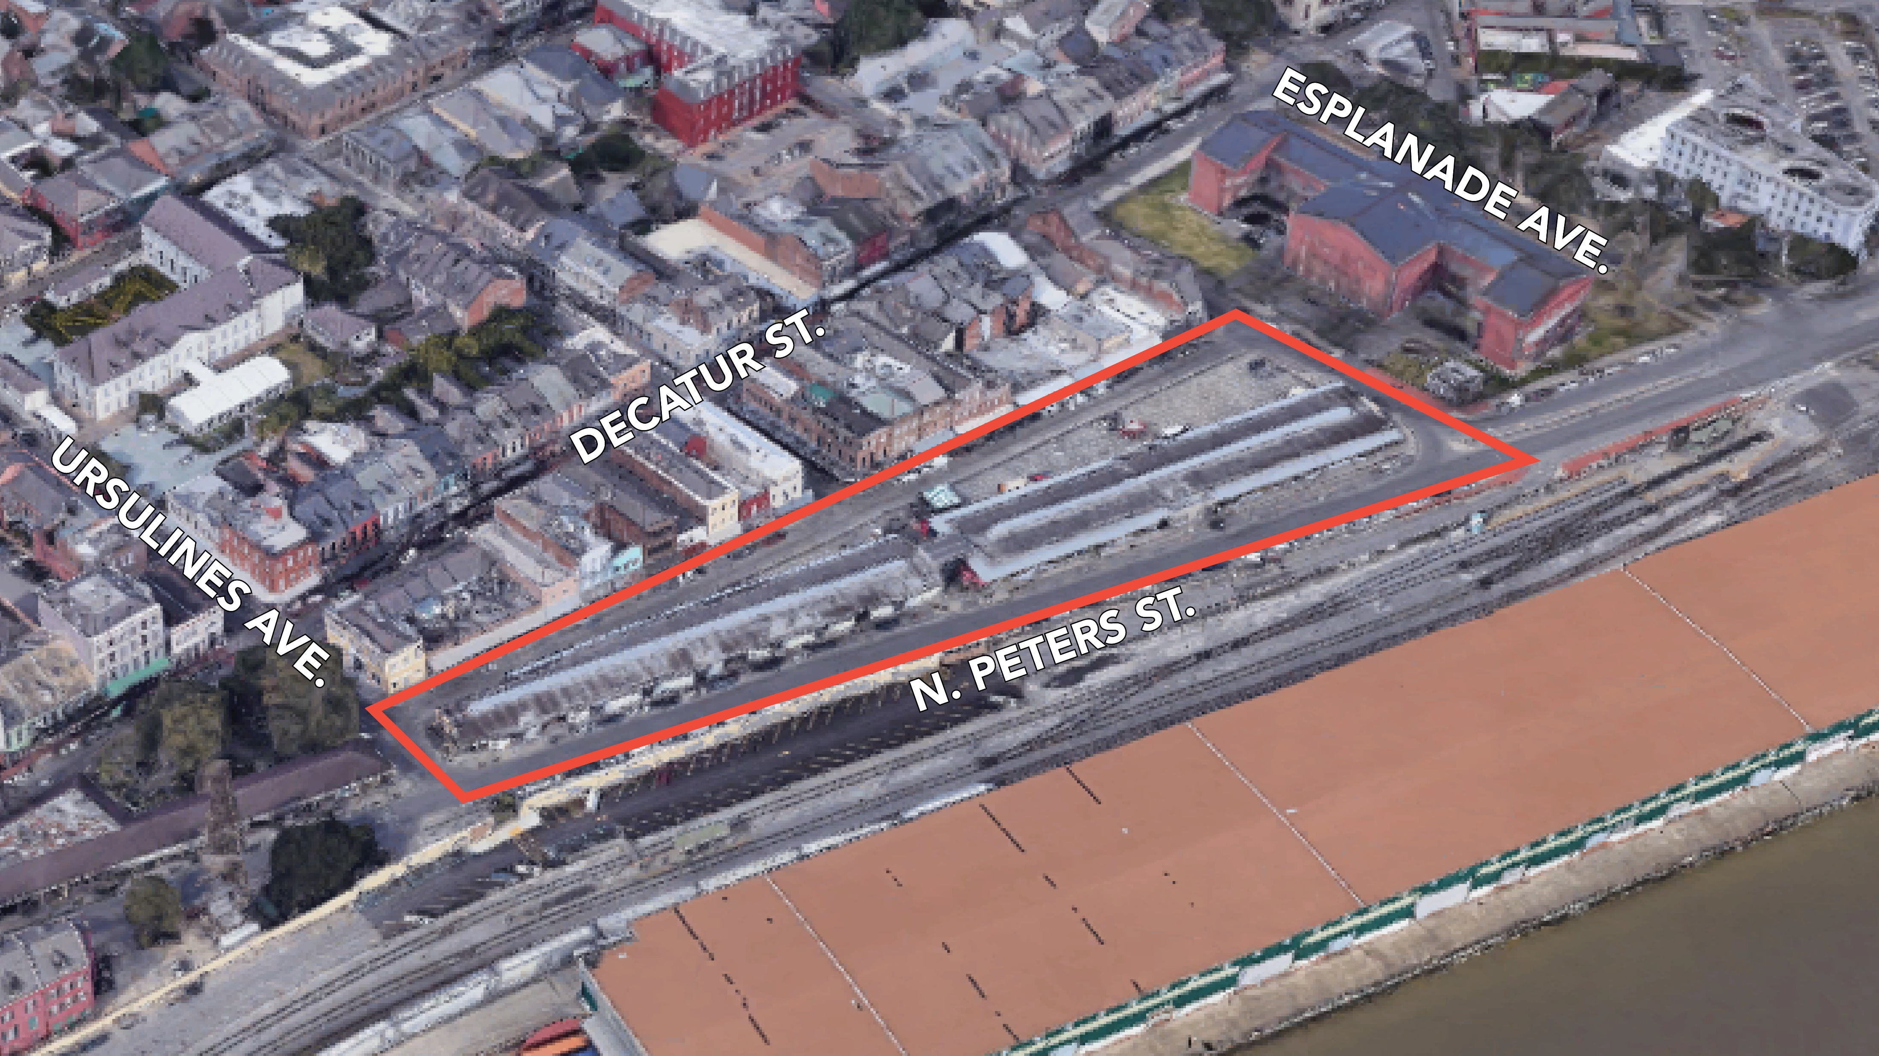
Notes:
In order to ground you, we are sharing this aerial map showing the are we are discussing: under the French Market Food & Flea sheds, outlined in red, here.

Slide 18
Nexus: A Holistic Framework
Social: Health & Wellbeing
Educational: Schools, Continued Learning
Cultural: Traditions, Arts, Religion
Organizational: Partnerships & Leadership
Economic: Finance & Business
Physical: Natural & Built Environment
Notes:
We invite you to start thinking about programming and operations under these FM sheds through a holistic lens. We at Concordia call this holistic framework, “Nexus” but I don’t want you to get bogged down with that word or this exact categories. Rather, we want you to be thinking holistically, not only about what programs you want to see at the French Market but the resources and partnerships that are needed to implement those programs successfully.

Slide 19
BREAKOUT ROOMS
Notes:
https://jamboard.google.com/d/1vQsv0ksG2wLevQj2VKQlj9zanqT28ffhQwySHNm1jQI/viewer?f=0
Before we get into breakout rooms…

Slide 20
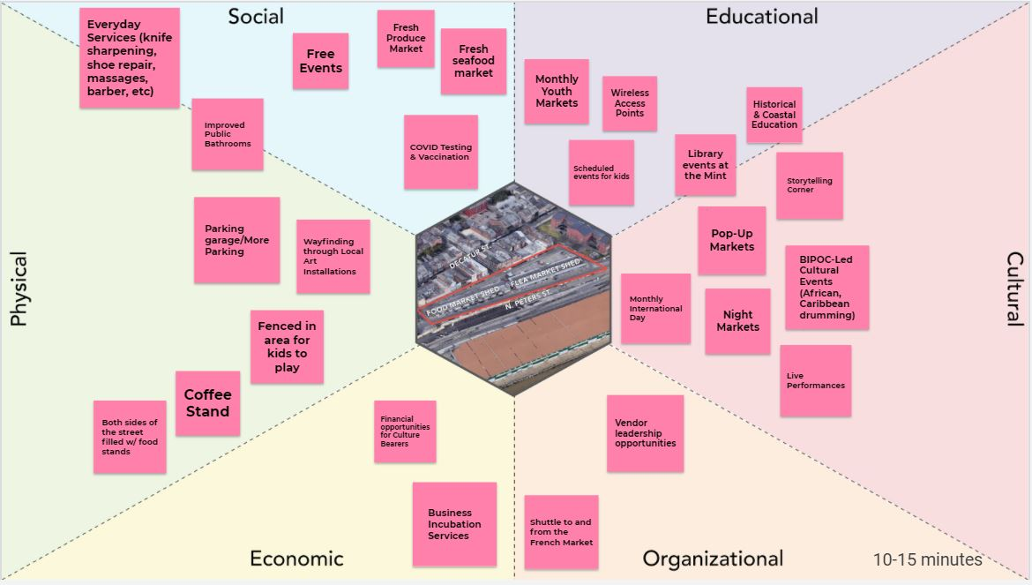
Breakout Room Activities
With your group, brainstorm program ideas for the French Market sheds.
Sort your program ideas by Nexus category and place them within the appropriate category on the jam-board.
As a group, identify your top 3 priority programs to discuss further.
Notes:
…I want to go over the two activities you’ll be participating in.
The first activity is a programming brainstorm which includes some program ideas that were offered in the first round of meetings. We invite you to review these ideas and add to them.
Again, don’t worry about your ideas fitting perfectly in each category. You’ll find that many programs fit into multiple categories. We are inviting you to use this framework as a jumping off point rather than a rigid system.

Slide 21
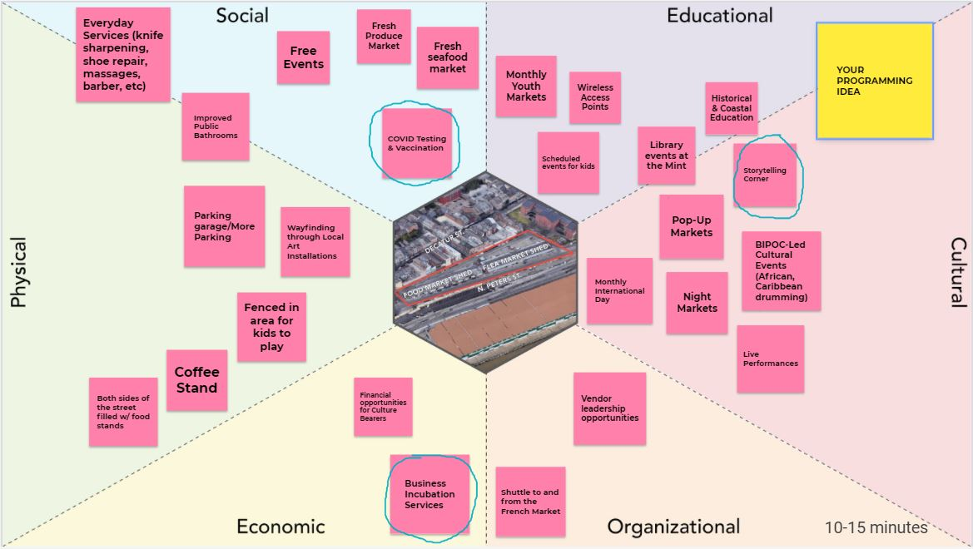
PROGRAM IDEA
PROGRAM IDEA
PROGRAM IDEA
PROGRAM IDEA
PROGRAM IDEA
PROGRAM IDEA
PROGRAM IDEA
PROGRAM IDEA
Notes:
Your first activity should look something like this when your group is done. The pink post-its are program ideas that we pulled from the first round of feedback. After reviewing these, we’d like you to add any additional program ideas on a different color post-it.
After your brainstorm, as a group – discuss and circle 3 priority programs.

Slide 22
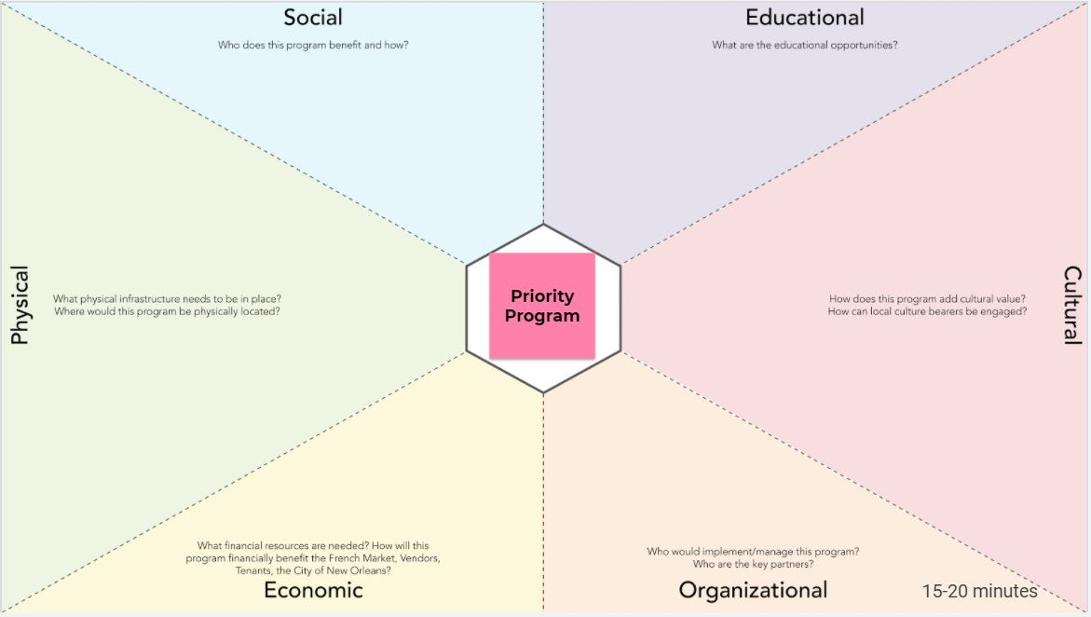
Breakout Room Activities
As a group, select one of your top 3 priority programs and type it into the center hexagon.
Discuss & write what opportunities are created by this program within each category. Also identify specific resources and partnerships that would be necessary to implement this program successfully.
Notes:
For the second jamboard, we ask that your group select one of the three priority programs to build out further, using the same holistic framework.

Slide 23
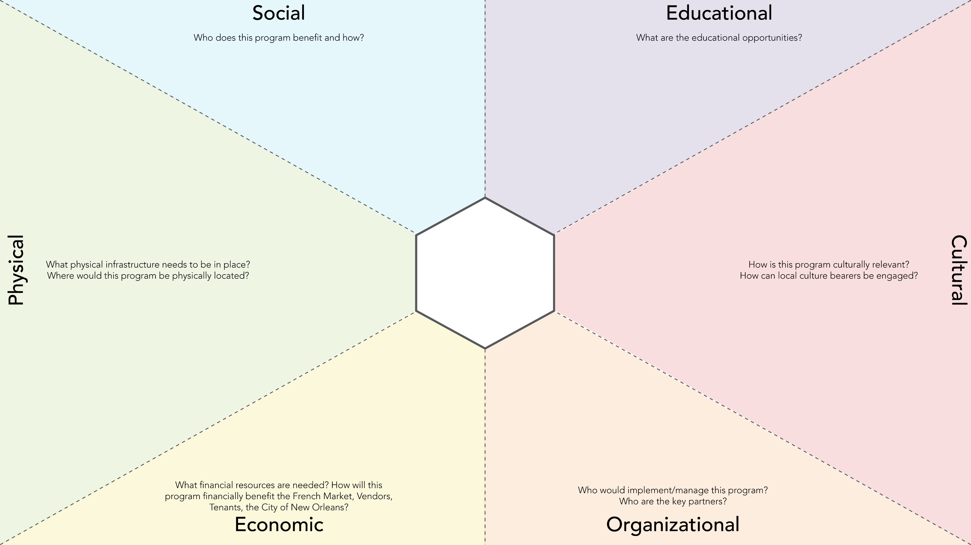
Popup Children's installations
Popup Art installations
Outdoor Dining at night
Teach about traditions through demonstrations & experience
Popup Barbershop (Local barbers can set up a chair)
Provide COVID Testing & Vaccination Pop-Up
Coordinate with US Mint for Educational opportunities
Allocate space under shed for pop-ups weekly or monthly.
Pop-up
Markets
Showcase International & Local Offerings
Popup nightlife
Popup Restaurants
Create additional revenue for FMC & attract business to existing vendors
Hire a coordinator & Partner
With other
markets
Protests and demonstrations of Solidarity
Popup Tax advice
Allow various coffee shops from outside the FQ to set up a stand
Notes:
So it will look something like this.
If you chose pop-up markets….

Slide 24
DEBRIEF & NEXT STEPS

Slide 25
Before you go…
Please fill out a survey!
Visit frenchmarket.org or follow the link shared in the chat. Please submit your completed surveys by 5:00pm, Friday, March 5th.

Slide 26
THANKS FOR YOUR
TIME & IDEAS!
Questions? Contact:
Leslie Alley: ltalley@frenchmarket.org
Bahareh Javadi: bjavadi@concordia.com

